Slide 1
The Role of Social Media in Da’awah
Najeeb A. A. Gambo
najeebaagambo@gmail.com
@TheNajeeb
2952C751
08146664666, 08035947438, 08089859999

Slide 2
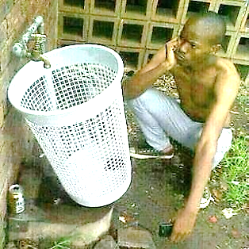

Slide 3
Presentation Outline
Working Definition
SM Classification
Criticisms
Benefits
Papal Case Study

Slide 4
Outline Contd.
Use of SM among DW
Missing links
Agenda for action

Slide 5
Why it is timely

Slide 6
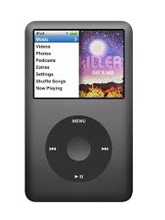
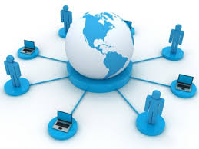
Years it take to reach a market audience of 50 million
38 years
2
years
3
years
13
years
4
years

Slide 7
“If Facebook were a country, it would be the FIRST LARGEST country in the world, BIGGER than China, India and U.S.”

Slide 8
“More than two-thirds of the world's Internet population visits social networking sites at least once a month, and nearly 10 percent of all time spent online is devoted to social networking” Nielson.

Slide 9
“1 in 5 divorces are blamed on Facebook” (Socialnomics Production)

Slide 10
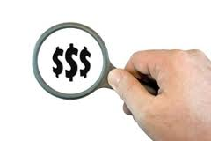
How does the ubiquity of SM affect Muslims, and how should Muslim respond to it?

Slide 11
Working Definition
“Social Media is a group of Internet-based applications that build on the ideological and technological foundations of Web 2.0, and that allow the creation and exchange of User Generated Content” (Kaplan and Heinlein 2010)

Slide 12
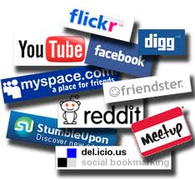
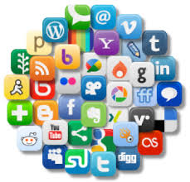

Slide 13
SM Classification
Collaborative projects (Wikipedia, Google Docs)
Social Networking Sites (Facebook, Myspace, LinkedIn)
Blogs and Microblogs (Wordpress, Blogger and Twitter)

Slide 14
Classification contd.
Content Communities (YouTube, Vimeo, DailyMotion)
Virtual Game Worlds (World of War Craft)
Virtual Social Worlds (Second Life)

Slide 15
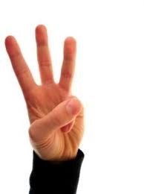
Criticisms

Slide 16
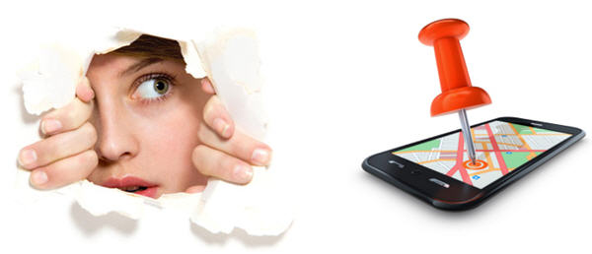
Privacy Invasion

Slide 17
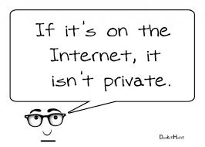

Slide 18
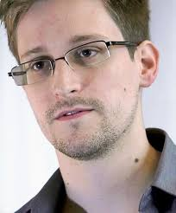

Slide 19
“NSA’s PRISM program is targeting nearly 120,000 internet users and is receiving live notifications when surveillance target use email and chat”

Slide 20
Google has every e-mail you ever sent or received on Gmail
It has every search you ever made
Has contents of every chat you ever had over Google Talk
It holds a record of every telephone conversation you had using Google Voice

Slide 21
It knows every Google Alert you've set up
It has your Google Calendar with all content going back as far as you've used it, including everything you've done every day since then…

Slide 22
It knows your contact list with all the information you may have included about yourself and the people you know
It has your Picasa pictures, your news page configuration, indicating what topics you're most interested in.
And so on
Frida Ghitis

Slide 23
Cyber - Stalking

Slide 24
“If a criminal can easily find out where you are, what stores you frequent, what your daily habits are, who your friends are, and even what your personal food, entertainment, and beverage preferences are, you can be targeted with a level of ease never before possible” (David Gewirtz)

Slide 25
Shell manager, businessman lured, killed by internet ‘lovers’ (The Nation Newspaper)

Slide 26
Nigeria’s 1st openly Facebook victim (Cynthia Osokogu)

Slide 27
Addiction & Distraction

Slide 28
A story of woman who used the WhatsApp messaging service so much so that she ended up in the hospital for spending an estimated six hours holding a weighty mobile phone while sending vast quantities of messages. Her physician diagnosed her as suffering from the bilateral extensor pollicislongus tendinitis of the thumb – or what they have nicknamed "WhatsAppitis”

Slide 29
A story of Danny Bowman who spent up to 10 hours each day taking up to 200 photos of himself on his iPhone and tried to kill himself because he didn't like any of the photos he had taken

Slide 30
In February 2014, a 24-year-old Indian woman who was confronted by her parents over her obsession with Facebook responded by hanging herself from a ceiling fan

Slide 31
Larry Carlat used to be a married editor of a famous men's magazine. Later he became obsessed with Twitter to the extent that he was given to choose choice: to delete the account or face termination (in his workplace) in which he chose Twitter and ultimately lost his job, A month later, he lost his wife after tweeting "I would've taken a bullet for my wife, but now I'd rather be the one pulling the trigger."

Slide 32
He claims to have reached his lowest point when his son threatened to stop following him on Twitter. After Tweeting as much as 30 times a day, seven days a week for over 3 years and amassing over 25,000 followers, Larry decided to commit “Twittercide” and left the social platform.

Slide 34
Malware, Phishing & Identity Scam
“It doesn’t matter how many firewalls, encryption software, certificates, or two-factor authentication mechanisms an organisation has if the person behind the keyboard falls for a phish” (Jason, 2012)

Slide 35
“A recent poll of IT managers by antivirus vendor Sophos indicate that a quarter of businesses have been the victim of spam, phishing or malware attacks via sites like Twitter, Facebook, LinkedIn and MySpace” (David Gewirtz)

Slide 36
“RSA estimates that worldwide losses from phishing attacks cost more than $1.5 billion in 2012, and had the potential to reach over $2 billion if the average uptime of phishing attacks had remained the same as 2011”

Slide 37
Digital Foot Print Blunder

Slide 38
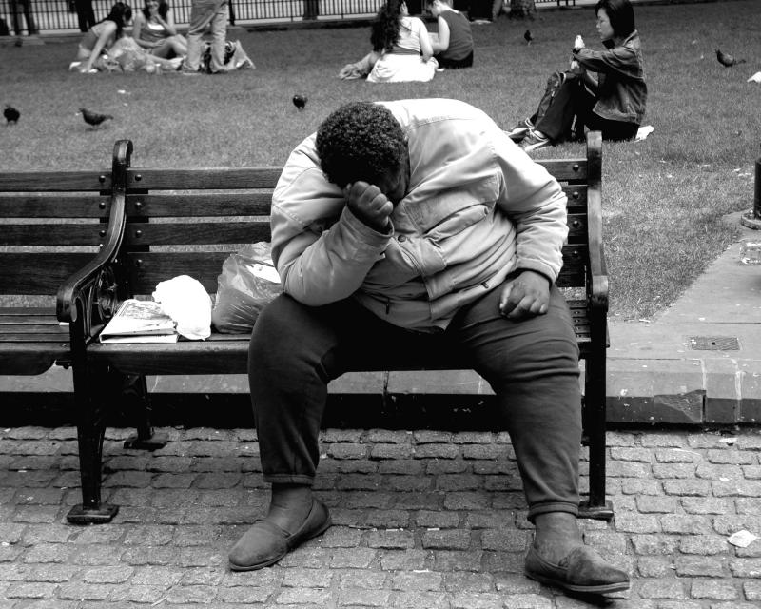
On Shekarau’s defection

Slide 39
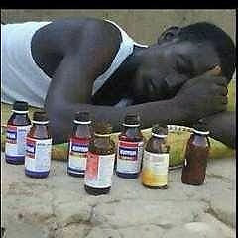

Slide 40
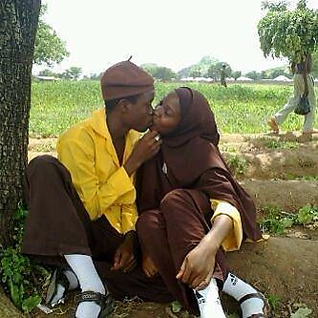

Slide 41
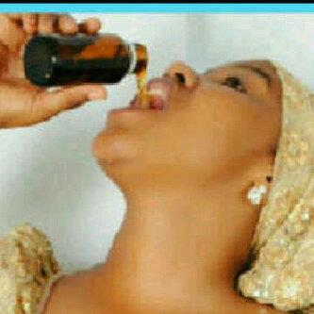

Slide 42
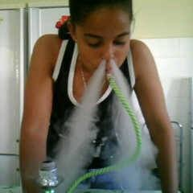

Slide 43
“People will one day change their name and reinvent themselves in order to escape their digital past.” Eric Schmidt Google CEO

Slide 45
Instrument for social unrest
“Everyone watching these horrific actions will be stuck by how they were organised via social media.”
PM David Cameroon

Slide 46
Breeding ground for cook up stories

Slide 47
Ebola Salt & Water Therapy

Slide 48
Photo alleging Boko Haram’s massacre of 375 Christians is fake – Premium Times

Slide 49
Angola accused of ‘banning’ Islam
Palestinians burn Angola's flag in a protest amid reports that the country has banned Islam and destroyed mosques
Photograph: APA/Rex
The Guardian, Thursday 28 November 2013

Slide 50
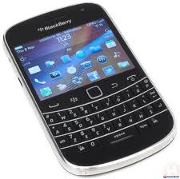
…Viral Damage

Slide 51
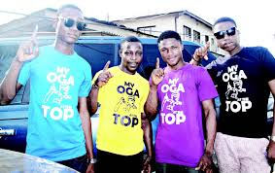
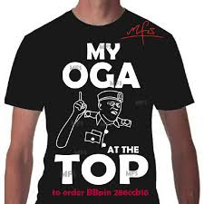
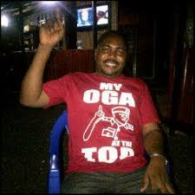
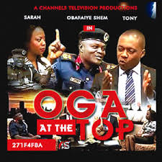

Slide 53
Some Benefits

Slide 54
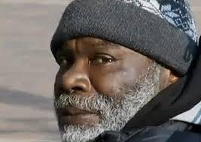
Social Media for Goods
GiveForward has helped raise $82,733,000 towards medical expenses
Billy Ray Harris ($191,745 = N31, 584, 236.40 from 8351 donors)
Kiva

Slide 55
Stephen Sutton (1994 – 2014)

Slide 56
Stephen Contd.
Initiated Teenage Cancer Trust
Used ‘Just Giving' platform to solicit £10, 000.00 (= NGN 2, 738, 790. 27)
Increased the target to £ 1, 000, 000. 00 = NGN 273, 875, 775.00
Raised £ 4,330,835.50 = NGN 11,621,939,887.36

Slide 57
Disabled Indian boy, 9, tied by his leg to bus stop on scorching summer's day so his grandmother can go to work
www.dailymail.co.uk
Notes:
Read more: http://www.dailymail.co.uk/news/article-2638653/Disabled-Indian-boy-Lakhan-Kale-tied-leg-bus-stop-grandmother-work.html#ixzz32qeiyKzr
Follow us: @MailOnline on Twitter | DailyMail on Facebook

Slide 58
Business

Slide 59
Prince William announced Tuesday that he and Middleton have divorced and that the entire marriage was "a tremendous mistake in every possible regard.“
www.onion.com

Slide 60
Nigeria’s Blogger Turned Businessman

Slide 61
SM as a tool for Criminal Investigation
"We use it (SM) to find out someone's whereabouts, to keep track of someone, learn who their associates are, and even get into their mental state by their posts that day."

Slide 62
Ukraine Case Study
“Dear subscriber, you are registered as a participant in a mass disturbance.”

Slide 63
Social Media Predictive Analytics can be used to see a criminal threat develop and alert law enforcement to intercede to prevent a crime from occurring.

Slide 64
Petition Platform

Slide 65
United Airline Case Study

Slide 66
Contd.
"..within four days of the song going online, the gathering thunderclouds of bad PR caused United Airlines' stock price to suffer a mid-flight stall, and it plunged by 10 percent, costing shareholders $180 million. Which, incidentally, would have bought Carroll more than 51,000 replacement guitars."

Slide 67
‘‘These days, one witty tweet, one clever blog post, one devastating video - forwarded to hundreds of friends at the click of a mouse - can snowball and kill a product or damage a company’s share price.’’
Tim Weber (2010)

Slide 68
Other Case studies
Kony 2012
Change.org

Slide 69
Social Movement
Social Media "for the first time provided activists with an opportunity to quickly disseminate information while bypassing government restrictions,"
(Hussein Amin, professor of mass communications at the American University in Cairo)

Slide 70
“We use Facebook to schedule the protests, Twitter to coordinate, and YouTube to tell the world”
A demonstrator

Slide 71
Media Houses
“I don’t know how you can exist as a reporter today without having access to multiple social media sites. Every news operation should have an ear and eye on Twitter during important breaking-news events.”
Mahaney

Slide 72
Contd.
“When a big crime story happens now, every reporter and producer attacks Facebook for information and sources”
(Paul LaRosa, a CBS News producer)

Slide 73
Contd.
“It’s the first thing we do, and everybody does it.” Why? Because Facebook worldwide includes more than 1 billion users searchable by names, occupations, hometowns, schools and interests”.

Slide 74
Contd.
“Each page is a potential lode of the biographical information that journalists crave. It also provides links to friends who might serve as secondary sources”.

Slide 75
Contd.
“I use social media mostly for three purposes, first, to reach family and friends of victims and suspects, and to get photos and gather information. Second, I use TweetDeck and other social media to gather intelligence and keep on top of trends and subjects”

Slide 76
Contd.
“Third, I use social media to build branding, get my name where it needs to be and build sources.”
Howard Altman, Tampa Tribune

Slide 77
Dynamic Emergency Environment
Boston Marathon Bombing
Queensland Cyclone
Hurricane Katrina
Haiti Earthquake

Slide 78
Papal Case Study

Slide 79
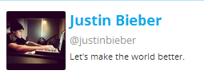
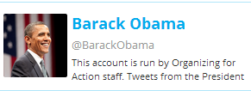
55, 805, 985
Followers
154
Following
6003
Tweets
53, 830, 731
Followers
139, 410
Following
27, 529
Tweets
45, 423, 488
Followers
648, 657
Following
12, 299
Tweets

Slide 80
Kate Perry, Justin Bieber and Barack Obama have more Twitter followers than the entire population in China

Slide 81
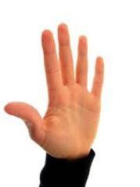
SM usage among Da’awah workers

Slide 82
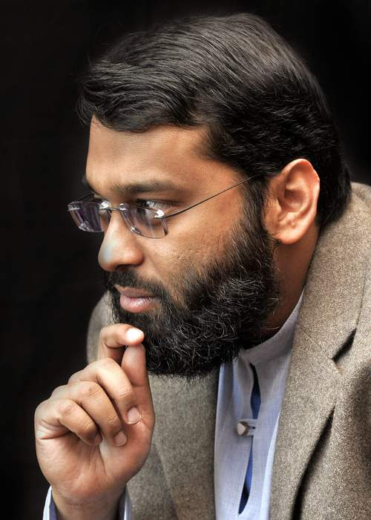
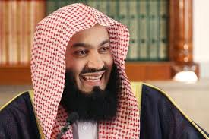
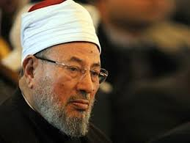
International Scene

Slide 83
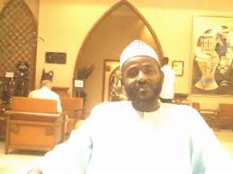
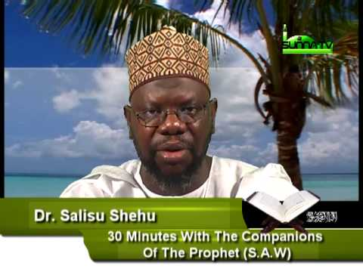
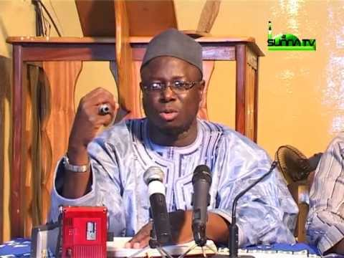
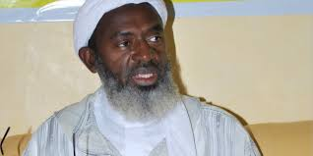
In Nigeria’s cyber space

Slide 84
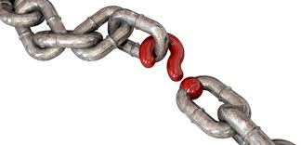
Missing Links
Curation
Multiple platform usage
User engagements
Digital sophistication

Slide 85
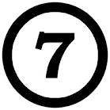
Agenda

Slide 86
“Under these rules of digital Darwinism (the survival of the loudest and most opinionated), the only way to intellectually prevail is by infinite filibustering”
Andrew Keen author of The Cult of the Amateur

Slide 87
SM Ecology & Users Demography
Sharing
Recruitments
Brand Ambassadors
Mentoring
Networking
Collaboration

Slide 88
Others
Training
Targeted Da’awah
International linkages

Slide 90
"If you think you are too small to be effective, you have never been in the dark with a mosquito."
Betty Reese

Slide 91
"We would accomplish many more things if we did not think of them as impossible”
Vince Lombardi

Slide 92
“We don’t have a choice on whether we Do social media, the question is how well we Do it” (Erik Qualman)

Slide 94
Useful Websites
GCF Learn Free (www.gcflearnfree.org)
RNTC (www.rntc.nl)
Coursera (www.coursera.org)
Edx (www.edx.org)
Book Boon (www.Bookboon.com)
United State Institute of Peace (www.usip.org)
United Nation Public Administration Network (www.unpan.org)
How Stuff Work (www.howstuffworks.com)
Stumble Upon (www.stumbleupon.com)
Islamic Online University (www.islamiconlineuniversity.com/bais)

Slide 95
To download this presentation, follow this Dropbox link https://db.tt/MzZETfiM

